Slide 1
Computation through intrinsic excitability
Andrew’s MCN 2024 Project

Slide 2
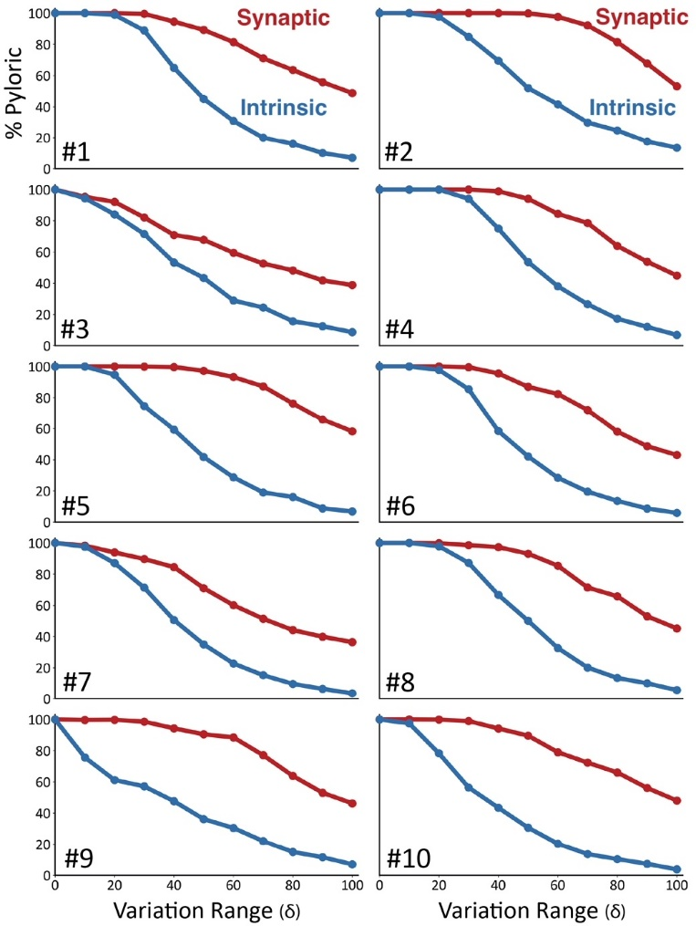
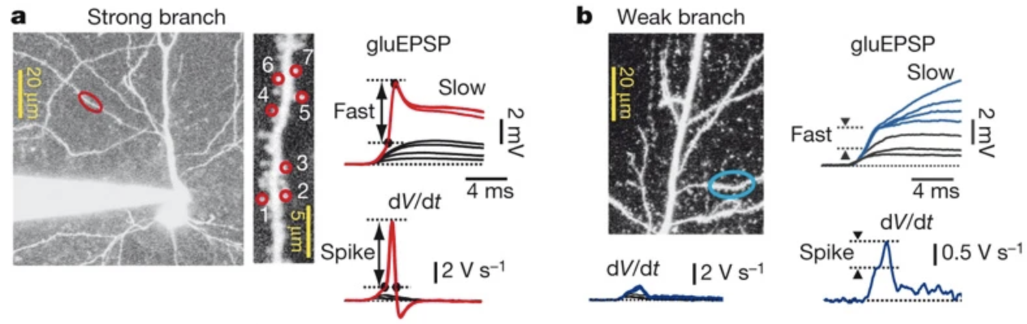
Losonczy, Makara & Magee, 2008
Fournier, Alonso & Marder, 2024

Slide 3
Questions:
How does the performance of spiking RNNs depend on intrinsic properties in comparison to synaptic connections?
Are intrinsic properties sufficient for learning simple computational tasks in spiking RNNs?

Slide 4
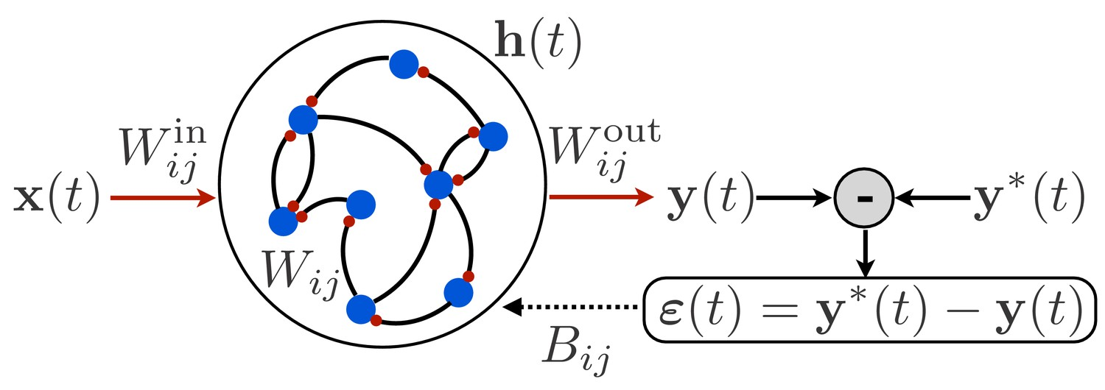
Questions:
How does the performance of spiking RNNs depend on intrinsic properties in comparison to synaptic connections?
Are intrinsic properties sufficient for learning simple computational tasks in spiking RNNs?
Methods:
Build spiking RNNs with integrate and fire neurons using the snnTorch package, which is fully equipped with differentiable spike mechanisms and uses standard pytorch structure.
Extend the base “leaky” class to contain standard voltage-dependent channels including the 1) transient potassium channel (A), hyperpolarization-activated channels (HCN), high-voltage-activated calcium channels (R-type VGCC). The max-conductance will be a learnable parameter.
If this all works, add a calcium parameter that is triggered by spikes and add a calcium-activated potassium channel (SK).
h(t):
- Contains learnable contribution of voltage-dependent channels that shape subthreshold membrane potential dynamics.

Slide 5
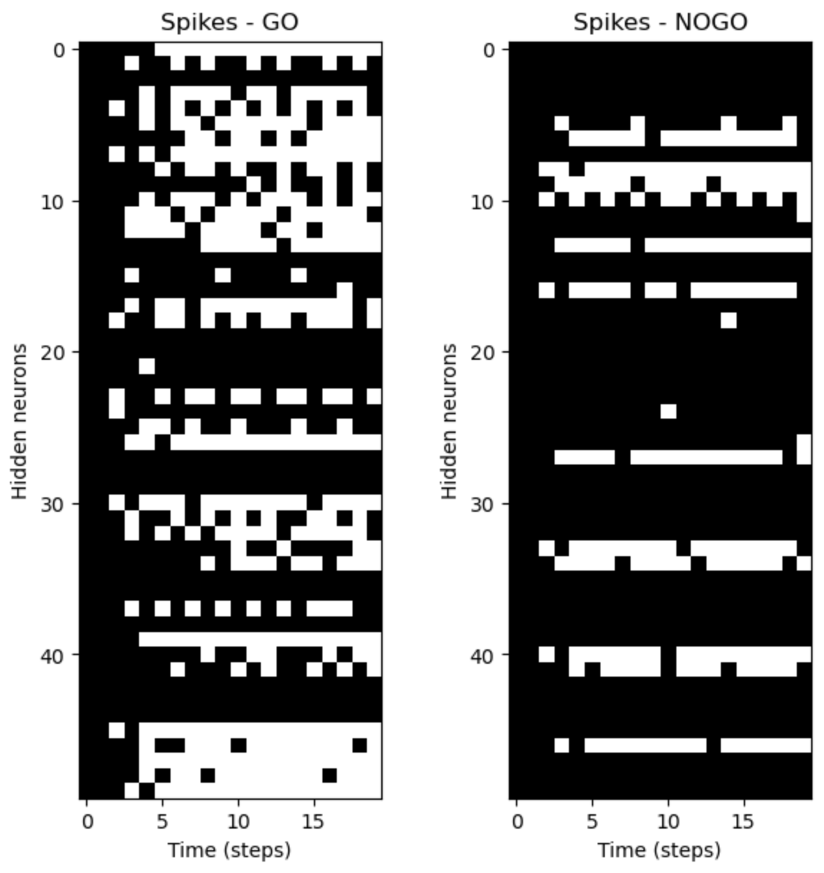
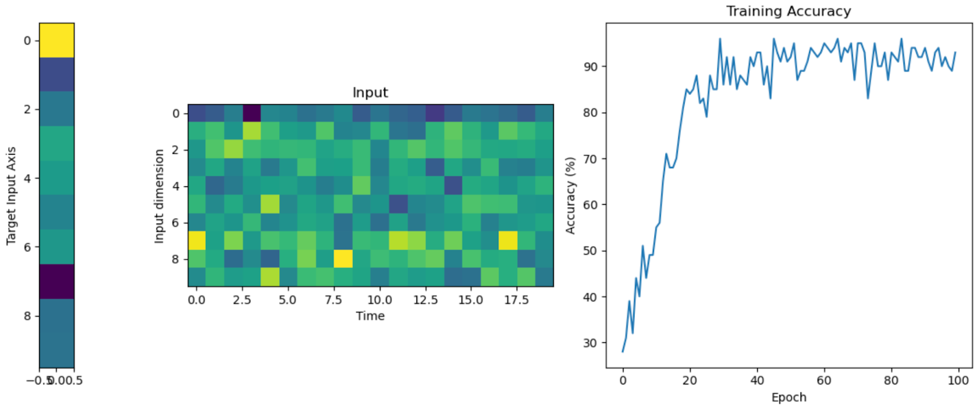
Analysis:
Train models on three simple tasks: 1) Go/No-go, 2) Context-dependent Go/No-go, 3) Delayed match-to-sample. There will be an input layer to spiking units, a recurrent layer, and a readout layer. The readout layer will integrate spikes and at the end of each trial, a softmax will be applied.
Train many copies of the networks on each tasks (independently). Perturb the parameters as Eve did, measure task performance.
Train networks with fixed synaptic weights such that they can only learn through modulating the strength of their intrinsic conductances.

